Slide 1
Effect of stop skipping on passenger travel time on the Washington Metro
By: Anoop Hariharan

Slide 2
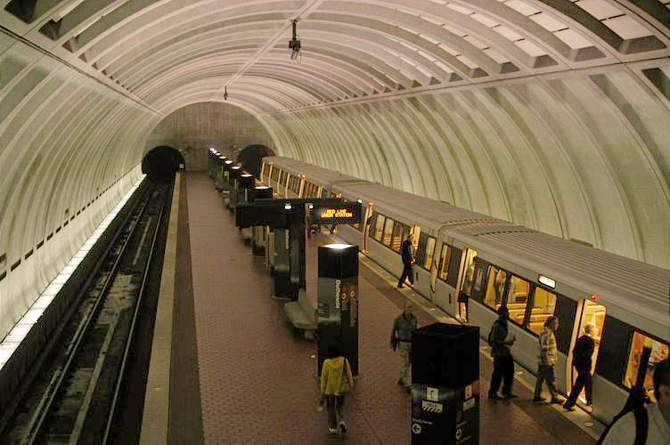
Problem
How can we reduce the time taken to travel on the Washington metro without significant investment in infrastructure?
Image Source: http://bit.ly/2z2aqIj

Slide 3
Purpose
Research the effects of a skip stop system on the Washington Metro using a continuous approximation model developed by (Freyss et. al, 2013).

Slide 4
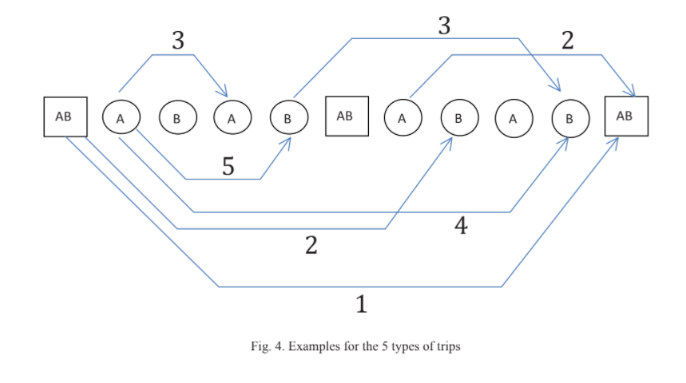
Conceptual Outline-Introduction to Stop Skipping (graphic)

Slide 5
Model Overview
I will be using a stop skipping model developed by (Freyss. et al) in Chile and applying it to the Washington Metro.
This model is a continuous approximation model (can operate on non-integer inputs and output non-integer values.)
More practical than to do a discrete optimization for the AB stations.

Slide 6
Constants for cost functions (for Washington Metro Silver Line)
λ: station density [Stations/m]= .0005879
N: number of passengers per unit of time starting a trip in each station [pax/s]= 0.1202296
Calculated from data file
nT: number of trains operating in each direction- filing a records request for this information
vl: cruising speed of the subway [m/s]= 14.7523
ts: dwell time in every station [s]= 30

Slide 7
Cost Function- Conceptual Overview
Model has two cost functions: one for normal operation and one for skip stop operation.
These cost functions are a sum of different costs, including travel cost, waiting cost, and transfer costs. Future costs to be added include traction cost and cruising speed costs.
Standard operation is not dependent on an input variable while skip stop operation is dependent on AB station density.

Slide 8
Cost Function- Equation

Slide 9
Different types of trips under a skip stop operation

Slide 10
Project workflow
Step 1
Step 2
Step 3
Step 4
Source data about metro operations from the Washington Metro
Excluding the parameters about energy, program the various functions of the continuous approximation model into Python Spyder
After identifying the optimal AB station density in the current model, find the cost of the skip stop operation at that density and compare it with the calculated normal operation cost.
Add additional parameters to the model, and extend it to a multivariate function (possibly utilizing neural networks) with boundary constraints for a reasonable train operation.

Slide 11
Work accomplished until Progress Report 1
Downloaded ridership dataset from WMATA
Contains information about what destinations passengers take from each destination.
Understood premise of the continuous approximation model
The different types of trips under a skip stop operation, and why a skip stop operation can increase waiting.
Started to program some of the functions into Python

Slide 12
Work accomplished thus far
Sourced parameters for Washington Metro
Train cruising speed, dwell time etc.
This may be modified when I get new information
Will be filing a public records request
Programmed entire skip stop model into Spyder and Jupyter Notebook
Excluded energy cost function for now
Generated a graph of the cost function using the py.plot library
Attempting to match with the ideal graphs given in the paper

Slide 13
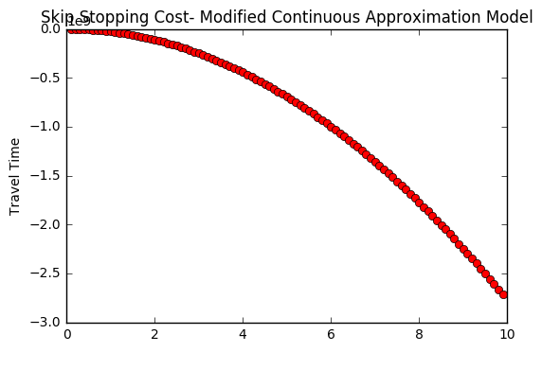
Graph (not a sample, but still needs work)
AB Station Density (stations/m)

Slide 14
References
Freyss, M., Giesen, R., & Muñoz, J. C. (2013). Continuous approximation for skip-stop
operation in rail transit. Transportation Research Part C: Emerging Technologies, 36,
419-433.
Vuchic, V. R. (1976). Skip-stop operation: High speed with good area coverage. UITP Revue,
114.

